Slide 1
Biophysical principles of signaling cluster formation: the Nephrin-Nck-Nwasp system
CAM Research in Progress talk
4th May, 2018
Ani Chattaraj
Advisor: Dr. Les Loew
Center for Cell Analysis & Modeling

Slide 2
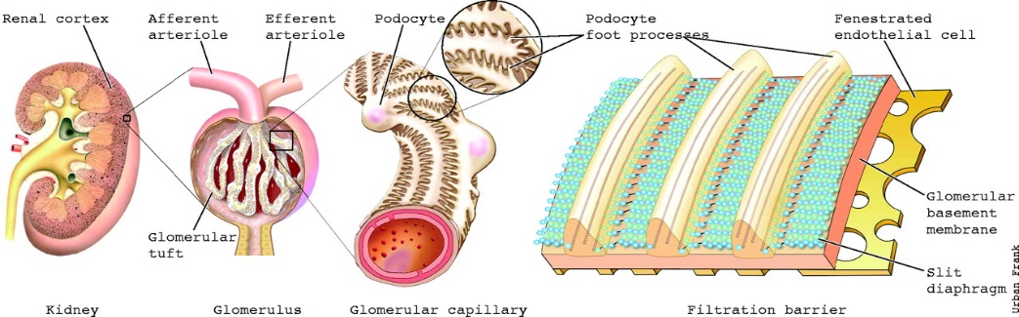
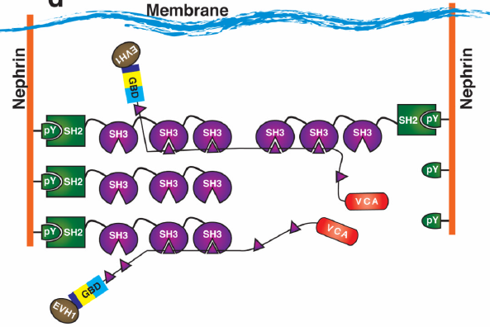
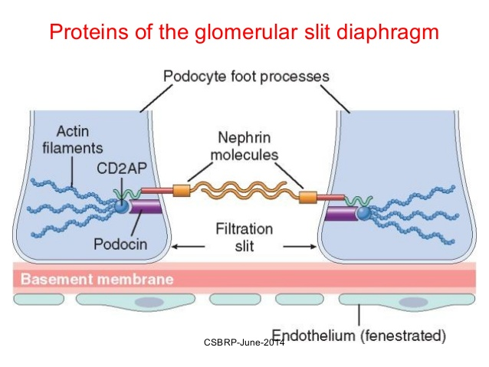
System of Interest
Transmembrane protein Nephrin
Adapter protein Nck
Effector protein Nwasp
https://image.slidesharecdn.com/gn-csbrp-151030053414-lva1-app6892/95/gn-csbrp-12-638.jpg?cb=1446183465
Annu. Rev. Biochem. 2010. 79: 709-35
Nephrin :
Intracellular part mediates cell signaling of actin remodeling inside podocyte
Extracellular part forms filtration barrier by interacting with neighboring nephrin

Slide 3
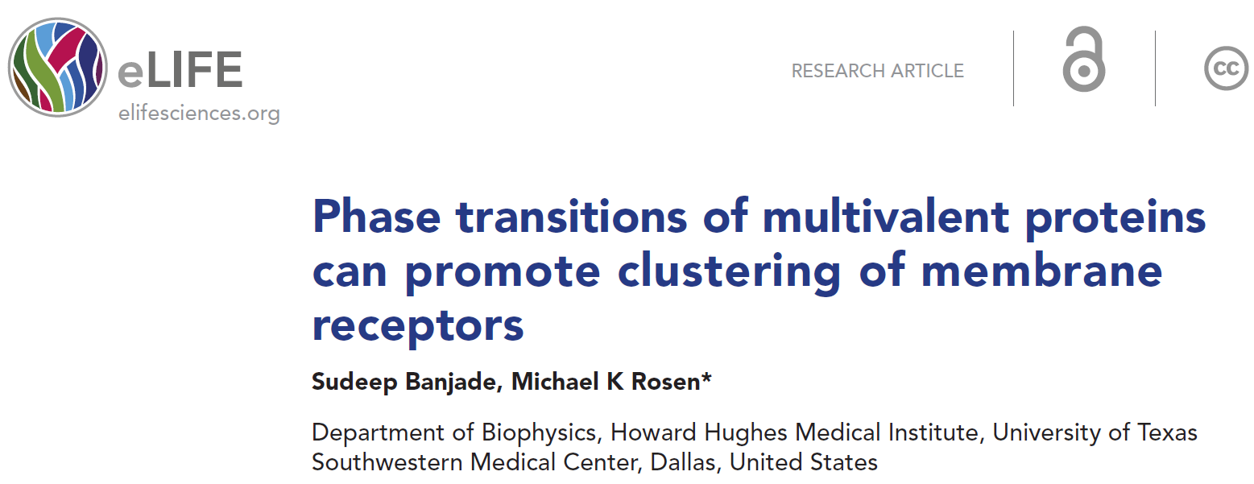
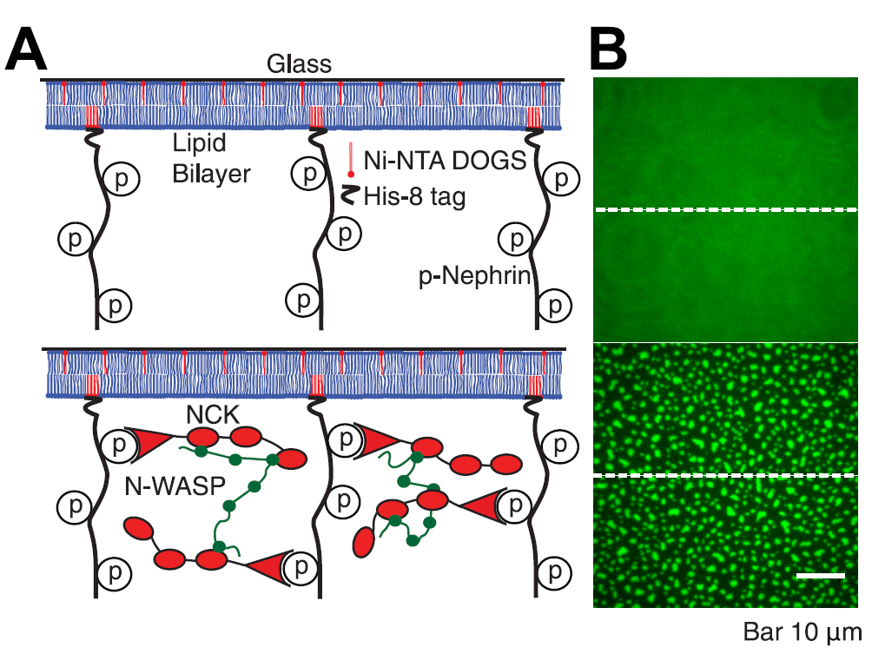
Motivation
Phase separated liquid droplet formation

Slide 4
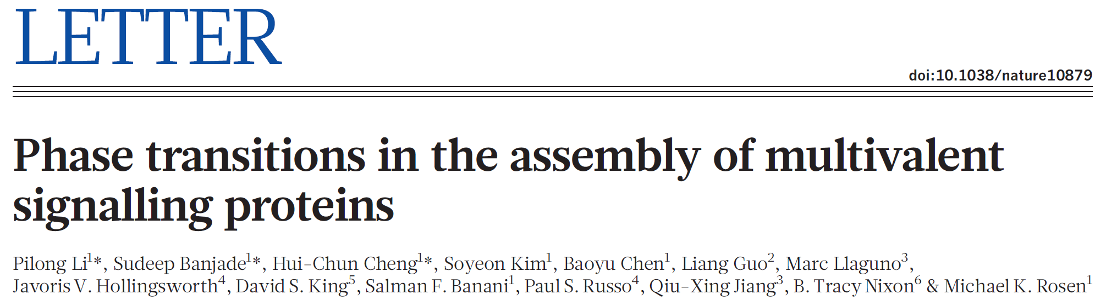
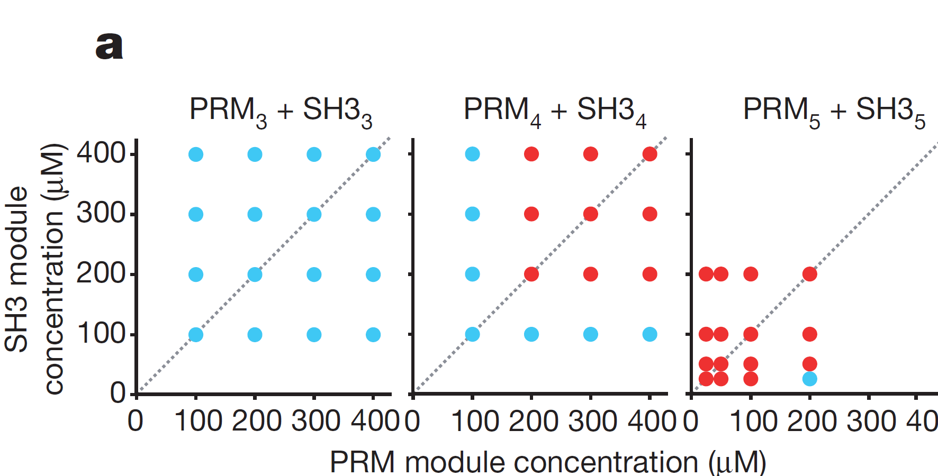
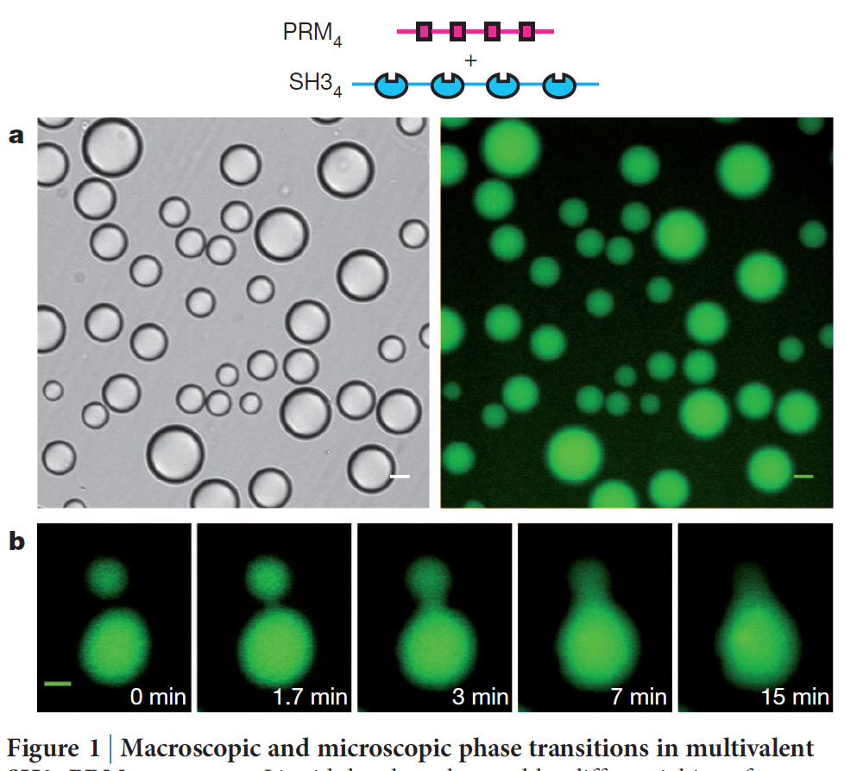
Phase separation
Phase separated structure
No phase separation, phase separation
Multi-valency driven phase separation
Droplet fusion
(Liquid-like behavior)

Slide 5
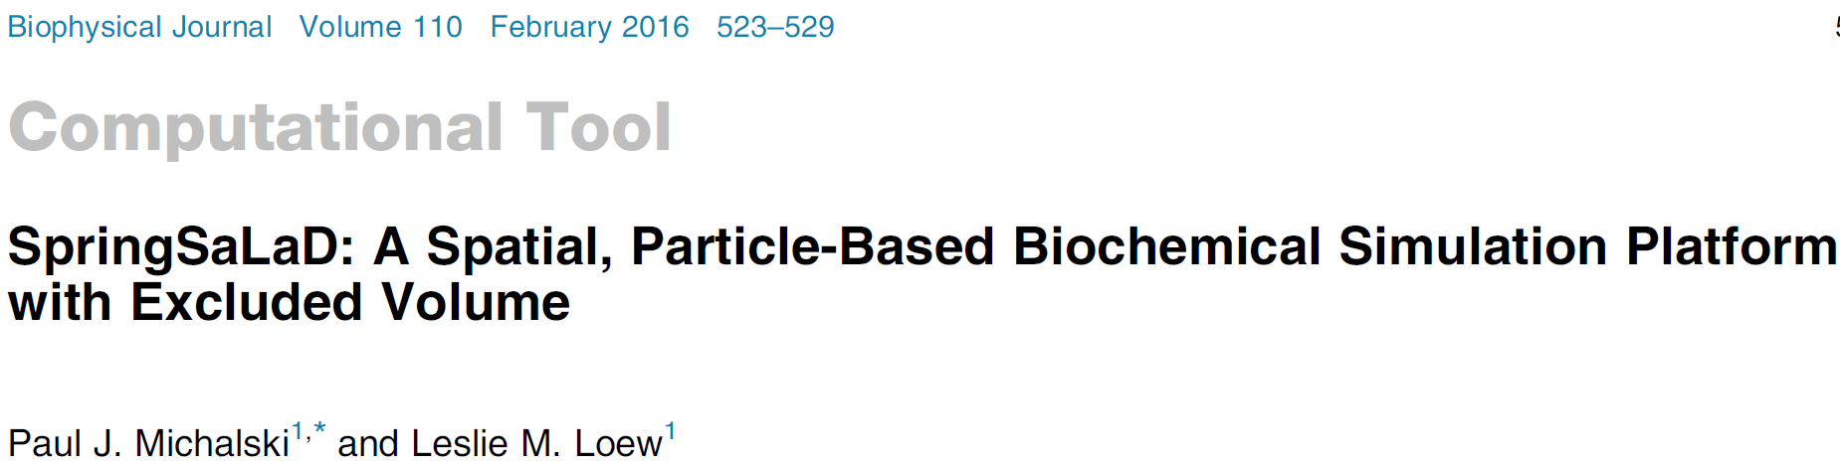
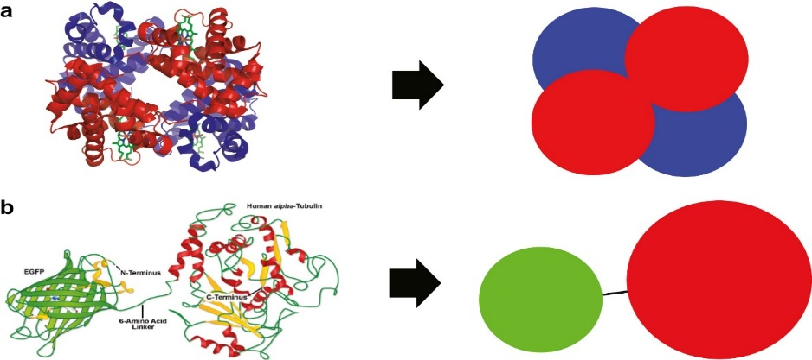
Computational tool
SpringSaLaD
Spring
Site
Langevin Dynamics
High viscosity (e.g., cytosol)
m d²r/dt² ~ 0 (overdamped condition)
ξ dr/dt = F(t) + F(r)
https://ars.els-cdn.com/content/image/1-s2.0-S0006349515048109-gr2_lrg.jpg
Langevin Dynamics
potential force
m d²r/dt² = - ξ dr/dt + F(t) + F(r)
Random fluctuating force
Force of inertia
Force
due to
viscous drag

Slide 6
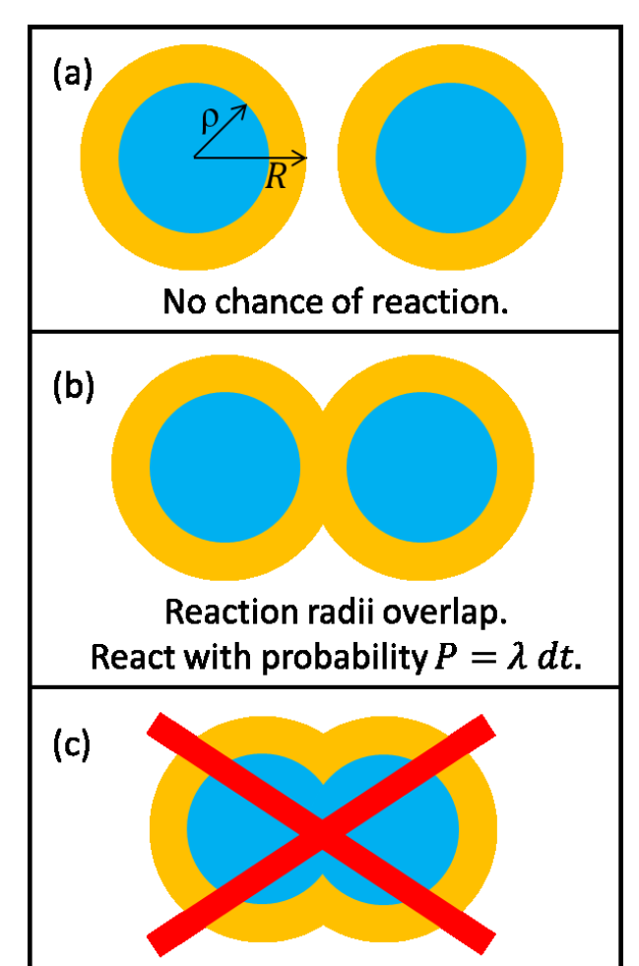
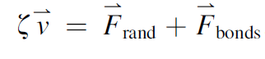
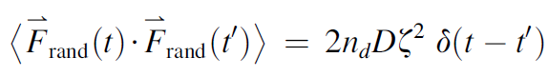
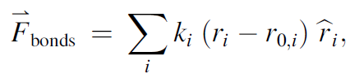
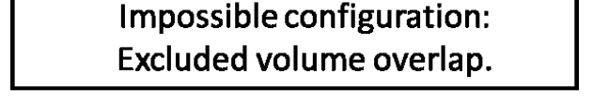
Computational tool
SpringSaLad
Each site is a ‘hard sphere’;
effect of ‘Excluded Volume’ .
https://ars.els-cdn.com/content/image/1-s2.0-S0006349515048109-gr2_lrg.jpg
R = reaction radius
ρ = physical radius
(ρ < R)
Spatial modeling platform (Diffusion driven dynamics)
Overdamped Langevin dynamics
Random force (uncorrelated in time; produce desired diffusion)
Bonds are stiff spring

Slide 7
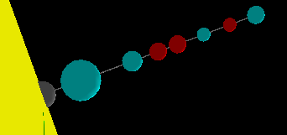
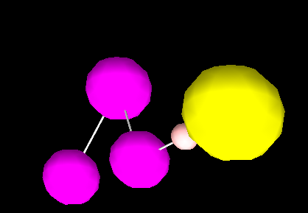
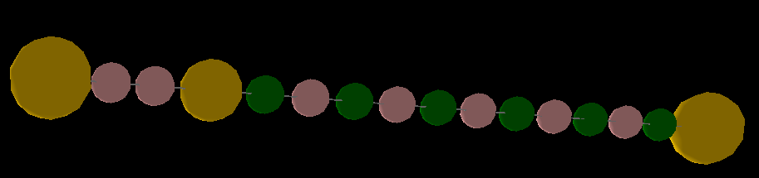
Model components
Nephrin
pTyr
Nck
SH3
SH2
NWASP
PRM

Slide 8
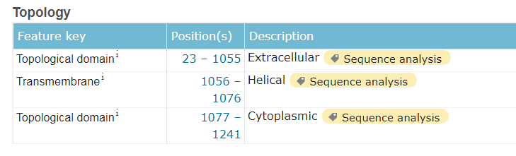
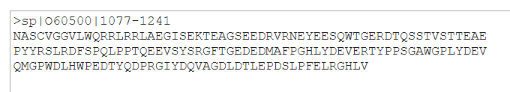
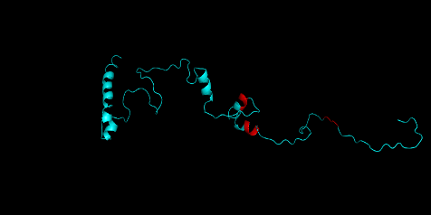
Molecule construction: Nephrin
Experimental structures of the whole aa sequence aren’t available
AA sequence
RaptorX/Phyre2
(homology modeling)
Secondary strucrure generation
http://www.uniprot.org/uniprot/O60500
RaptorX
Coarse graining
(domain construction)

Slide 9
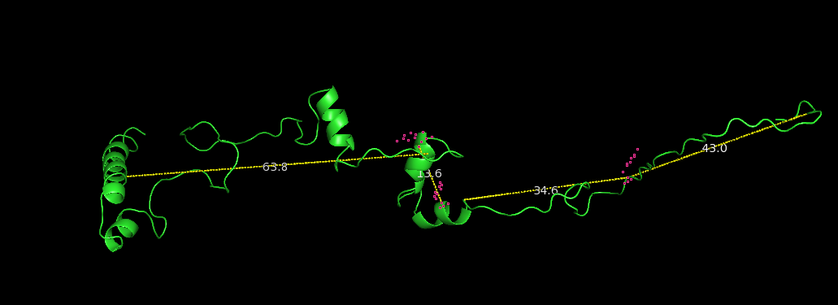
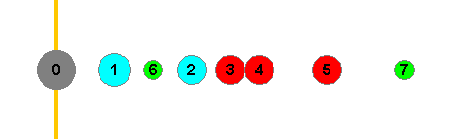
Nephrin
3.5 nm
6 nm
4 nm
15 nm

Slide 10
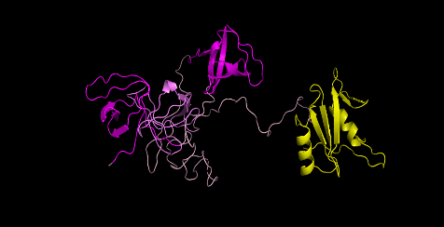
Molecule construction: NCK
http://www.uniprot.org/uniprot/P16333
RaptorX
Nck

Slide 11
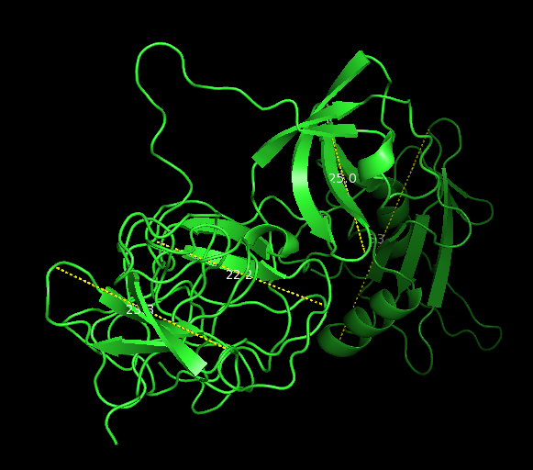
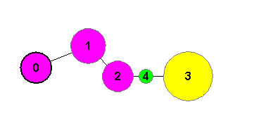
NCK
d ~ 2.5 nm
d = 2.5 nm
d = 2.2 nm
d = 3.5 nm
d ~ 2.2 nm
d ~ 3.4 nm
d = 2.2 nm
5 nm
d ~ 2.3 nm

Slide 12
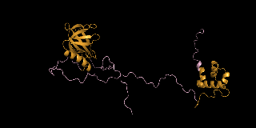
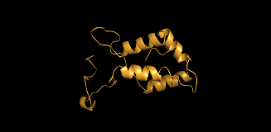
Molecule construction: NWASP
https://www.uniprot.org/uniprot/O00401
AA seq: 1 - 276
AA seq: 277-392
AA seq: 393 - 505
?
?
?
Proline rich sequence; highly disordered; no predicted secondary structure.
PP2 helix : 0.31 nm/ residue
117 residues ~ 36 nm
(six PRM motif for SH3)
35 nm

Slide 13
Biochemical affinities: kinetic parameters
pY-SH2 :
K_{D} = 1 uM
K_{on} = 100 uM ⁻¹s ⁻¹
K_{off} = 100 s ⁻¹

Slide 14
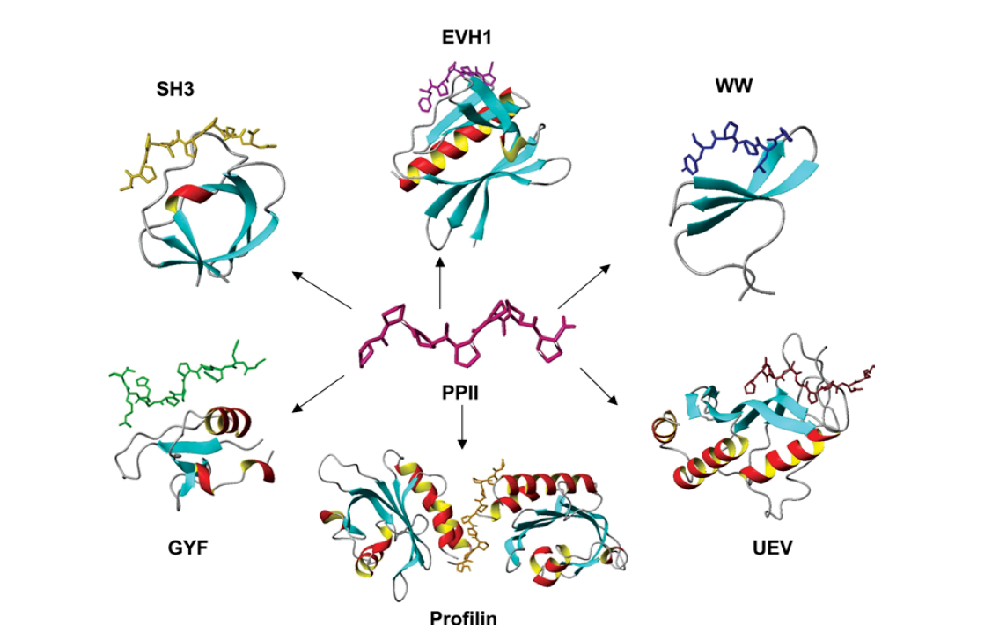
Biochemical affinities: kinetic parameters
PRM – SH3 :
K_{D} = 100 uM
K_{on} = 100 uM ⁻¹s ⁻¹
K_{off} = 10000 s ⁻¹

Slide 15
Diffusion constants
Molecular site | D (µm²/s)
Nephrin_anchor site | 0.05
Nephrin _cytosolic sites | 1
Nck sites | 2
Nwasp sites | 2

Slide 16
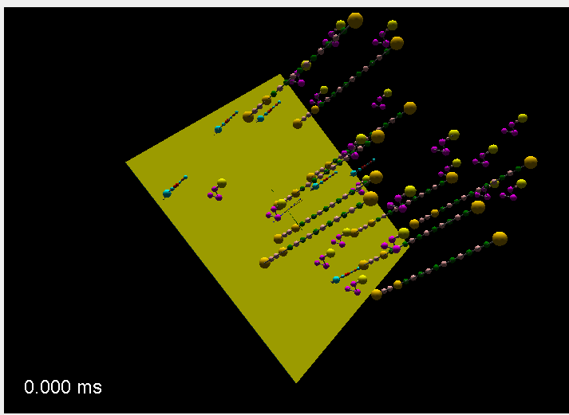
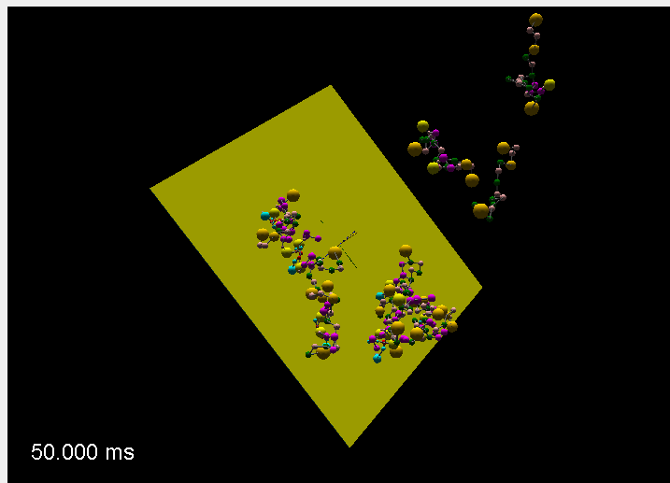
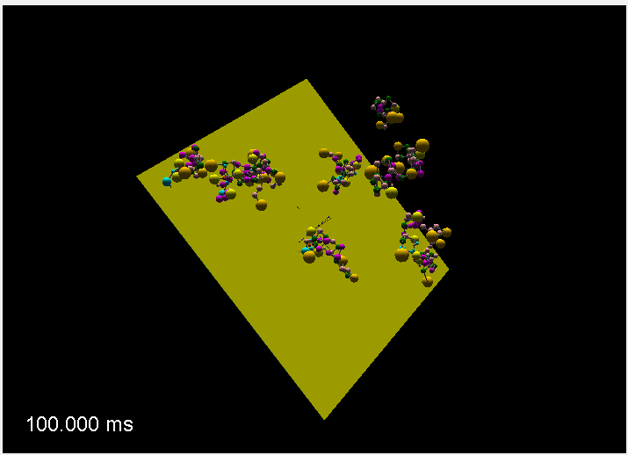
Multivalent interaction: clustering dynamics
x
Z
Y
Cubic reaction volume (X = Y = Z = 100 nm) (zero-flux BC)
XY surface : membrane
Molecules : 36 (6 Nephrin, 20 Nck, 10 Nwasp)
(Video demo)

Slide 17
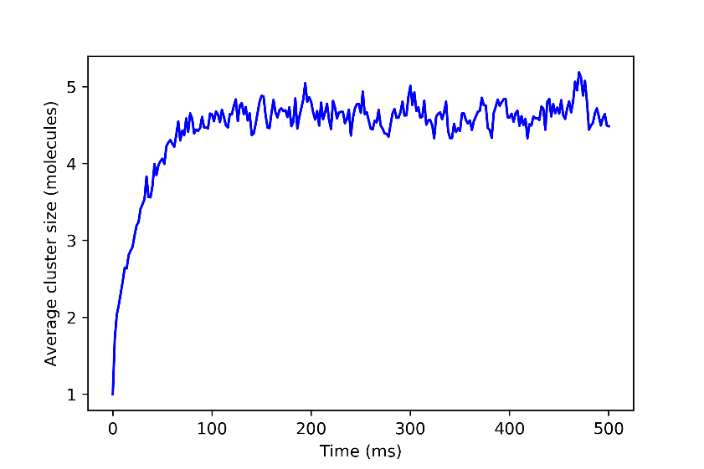
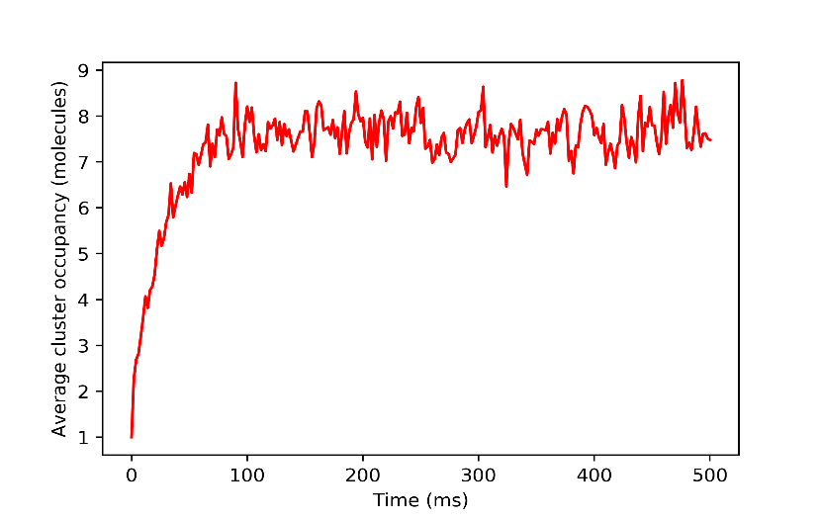
Result analysis: two representations
(50 trajectories)
ACS : Average Cluster Size
Let’s say, total number of molecules = 36
Five clusters present in the system: (1, 1, 5, 11, 18) (at a single time point)
Method_1, ACS = 36/5 = 7.2
Method_2, ACS = (0.4 * 1) + (0.2 * 5) + (0.2 * 11) + (0.2 * 18) = 7.2
Now we calculate the fraction of total molecules (FoTM) that are present in each individual cluster.
FoTM_1 = 2 * (1/36)
FoTM_5 = 1 * (5/36)
FoTM_11 = 1 * (11/36)
FoTM_18 = 1 * (18/36)
Multiplying the FoTM with respective cluster sizes yields average cluster occupancy.
ACO = (1 * FoTM_1) + (5 * FoTM_5) + (11 * FoTM_11) + (18 * FoTM_18) = 0.05 + 0.69 + 3.36 + 9 = 13.1
ACO : Average Cluster Occupancy

Slide 18
Result analysis: two representations
For constant total number of molecules,
ACO = f (number & size of clusters)
Total molecules = 36
Single trajectory, single time point
ACS = f (number of clusters)
Clusters | Average Cluster Size | Average Cluster Occupancy
12, 12, 12 | 12 | 12
2, 9, 25 | 12 | 19.72
6, 11, 19 | 12 | 14.38
18, 18 | 18 | 18
1, 35 | 18 | 34.05
9, 9, 9, 9 | 9 | 9
4, 7, 11, 14 | 9 | 10.61
1, 5, 10, 20 | 9 | 14.61
2, 3, 13, 18 | 9 | 14.05

Slide 19
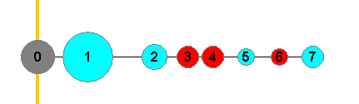
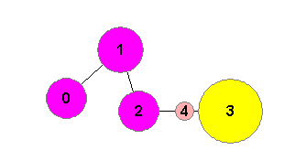
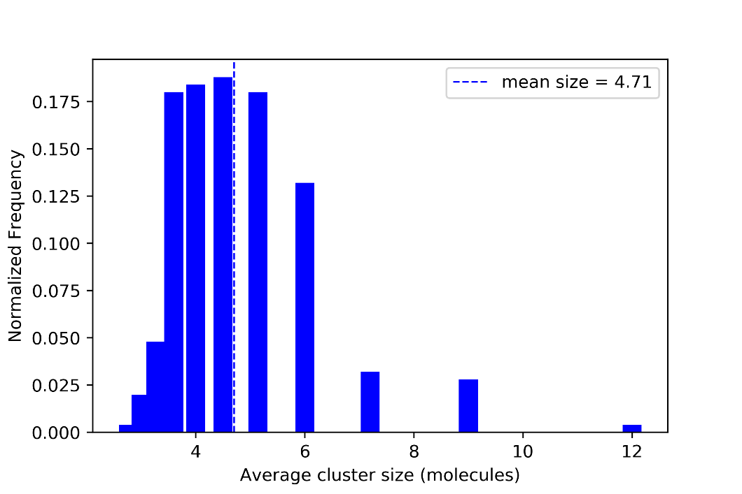
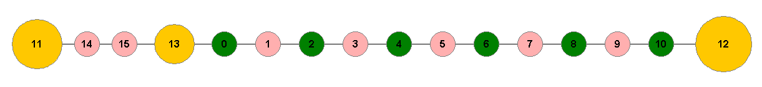
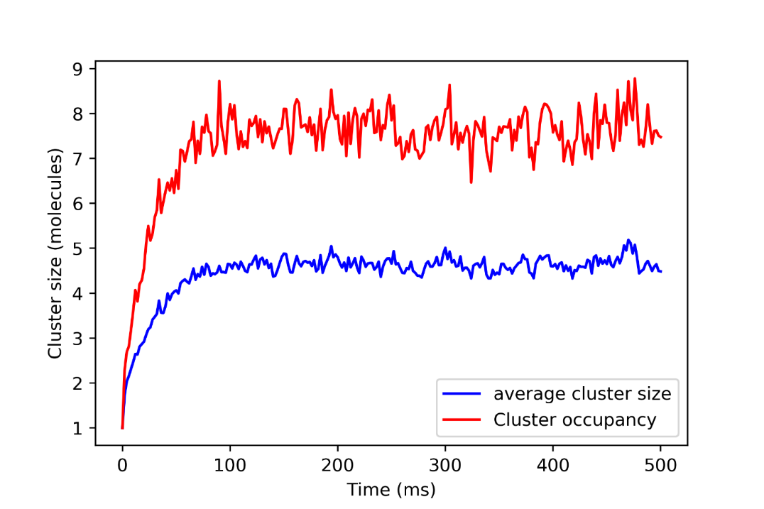
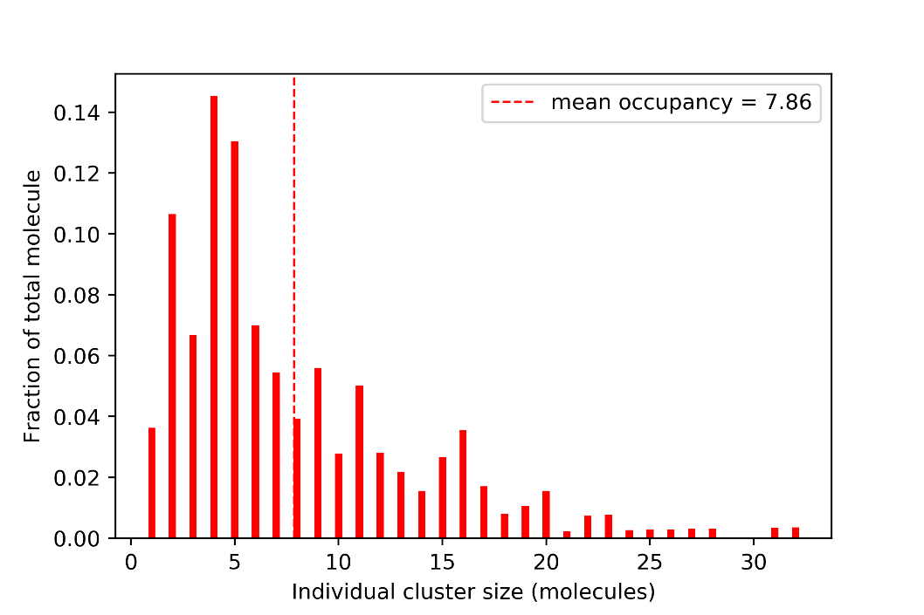
6
Control / reference system
20
10
Number of molecules
Time to reach steady state ~ 100 ms
Assumption:
In steady state, after 100 ms, new equilibrium is achieved
5*50 = 250 independent realizations: Mean & variability

Slide 20


Result analysis
Total number of molecules = 36
Average cluster size = Total molecules / number of cluster
ACS = { 36 / n } for n = 1, 2, 3, ……, 36
Possible ACS : {36, 18, 12, 9, 7.2, 6, …,4.5 ,4, …, 3,...,1}
Composition (neph, nck, nwasp) of individual cluster
C2 : (0,1,1) 96% (1,1,0) 4%
C4 : (1,2,1) 98% (0,3,1) 1% (0,2,2) 1%
C5 : (1,3,1) 96% (1,2,2) 2% (0,3,2) 1%
C6 : (1,3,2) 91%

Slide 21
Binding sites stoichiometry
Result analysis
Exact stoichiometry
pY : SH2, SH3 : PRM = 3:1, 1:2
Nephrin : Nck : Nwasp = 1 : 3 : 1.5
(example: 2, 6, 3 ; 6, 18, 9)
pY: SH2 = 3:1
SH3: PRM = 3:6 = 1:2
Composition (neph, nck, nwasp) of individual cluster
C2 : (0,1,1) 96% (1,1,0) 4%
C4 : (1,2,1) 98% (0,3,1) 1% (0,2,2) 1%
C5 : (1,3,1) 96% (1,2,2) 2% (0,3,2) 1%
C6 : (1,3,2) 91%

Slide 22
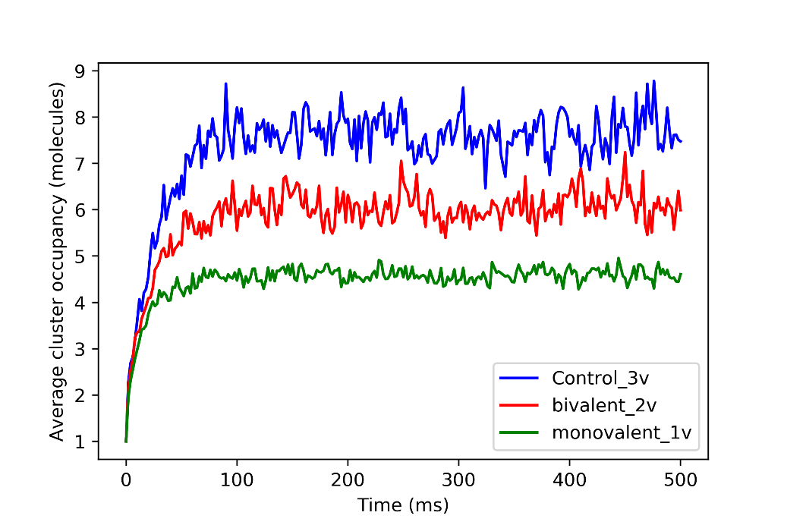
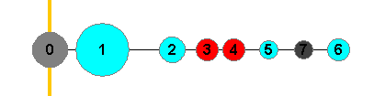
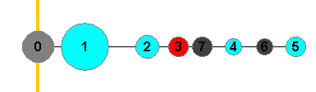
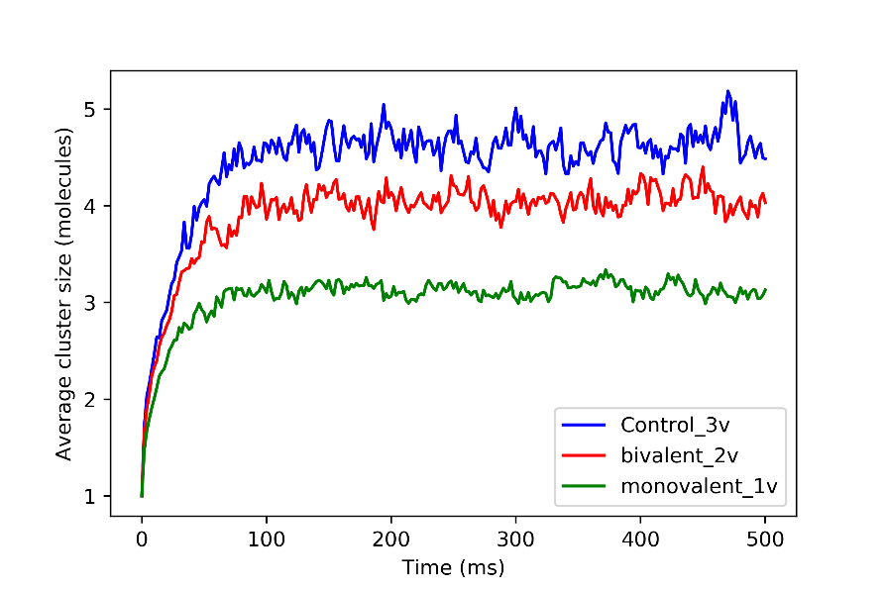
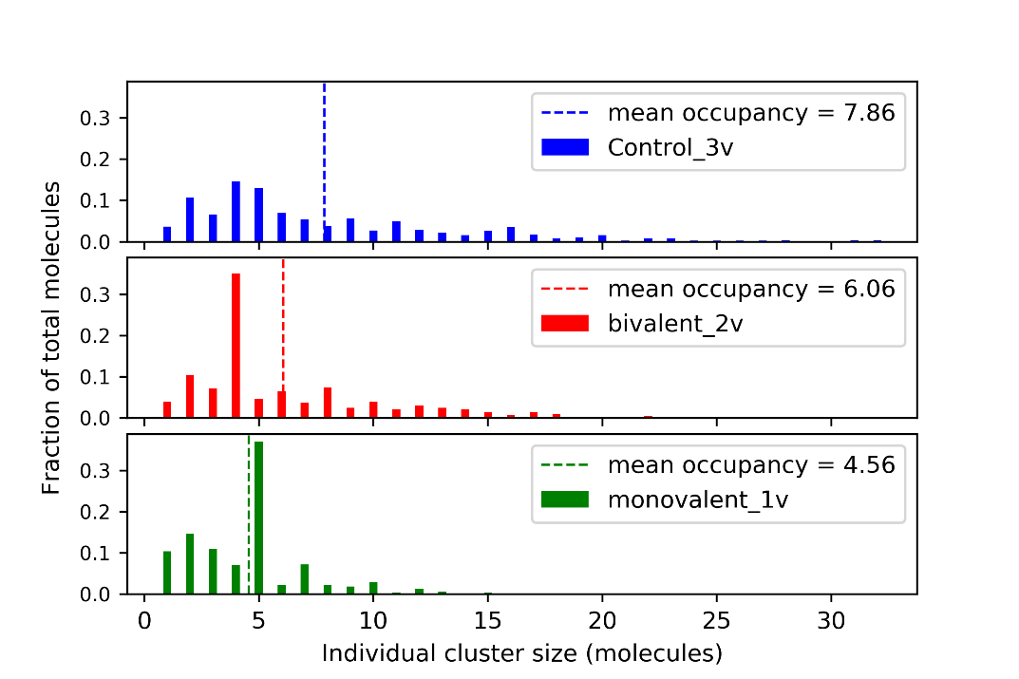
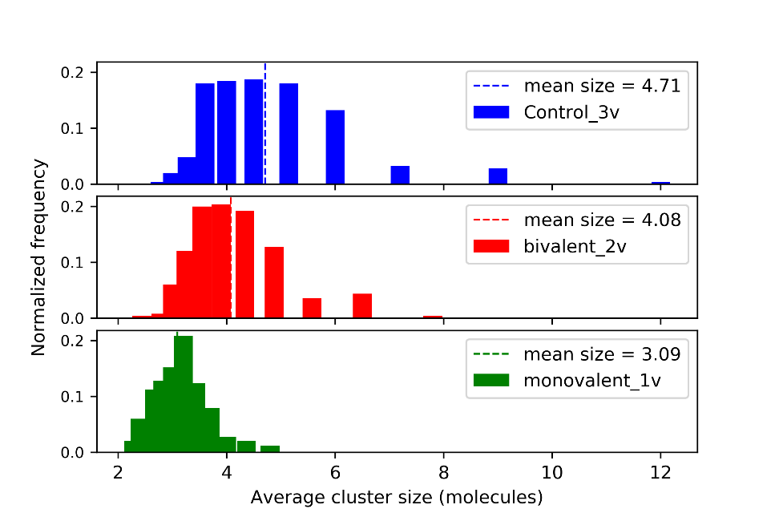
Effect of multivalency
3v * 6 = 18 pY
2v * 9 = 18 pY
Guess ! what should happen?
1v * 18 = 18 pY
Nephrin phosphorylation level could trigger downstream signaling by altering the cluster state

Slide 23
Effect of multivalency
3v * 6 = 18 pY
2v * 9 = 18 pY
1v * 18 = 18 pY
Binding site stoichiometry dictates the preferred cluster composition
Exact stoichiometry
2v system: pY : SH2, SH3 : PRM = 2:1, 1:2
Nephrin, Nck, Nwasp = 1, 2, 1
1v system: pY : SH2, SH3 : PRM = 1:1, 1:2
Nephrin, Nck, Nwasp = 2, 2, 1
Composition (Nephrin, Nck, Nwasp)
2v system
C4 : (1,2,1) 99.4% (0,3,1) 0.35% (0,2,2) 0.23%
1v system
C5 : (2,2,1) 98.7% (1,3,1) 0.56% (1,2,2) 0.11% (0,3,2) 0.56%

Slide 24
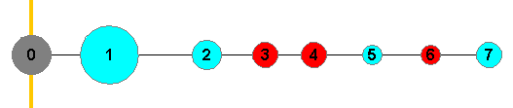
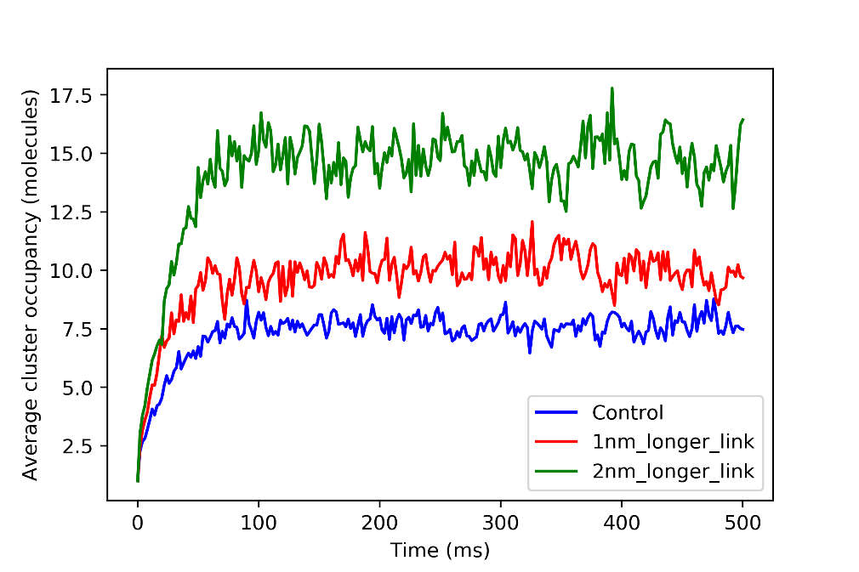
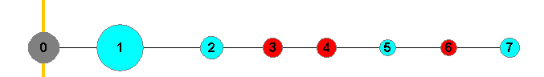
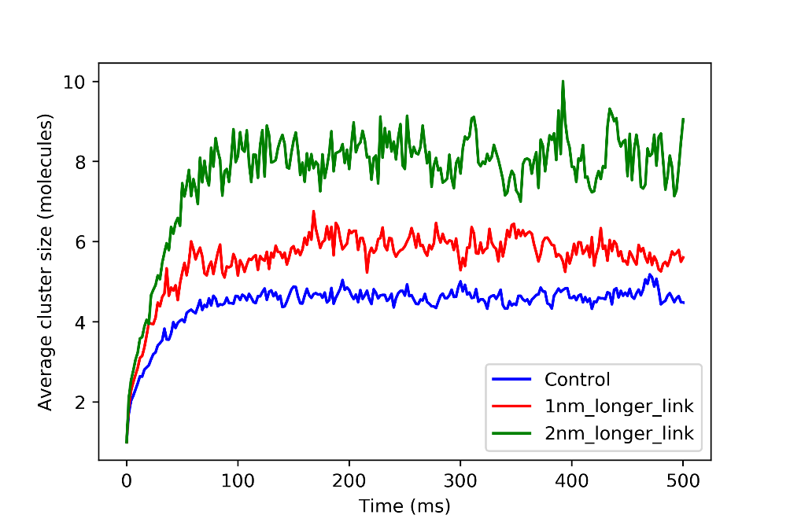


Effect of linker length
Control : L_{ij}
1 nm longer : L_{ij} + 1
2 nm longer : L_{ij} + 2
i = nephrin, nck, nwasp
j = inter-site linker within i
Less steric hindrance, larger cluster

Slide 25






Effect of structural sites
Guess ! what should happen?
Binding Sites Only
Structural sites : (1) steric factor
(2) Flexibility

Slide 26





Effect of structural sites: steric effect
Smaller structural sites
Larger structural sites
Similar flexibility;
Different steric effect

Slide 27




Effect of structural sites: flexibility
1
2
3

Slide 28





Anchoring effect
Membrane as a steric plane (Inhibitor)
Enhanced local concentration due to confinement (Inducer)

Slide 29




Anchoring effect
Anchoring length
Membrane as a steric plane (Inhibitor)
Enhanced local concentration due to confinement (Inducer)
Minor effect
AL = 3 nm
AL = 7 nm
AL = 11 nm

Slide 30








Anchoring effect
Overall increase
in
clustering potential
Membrane as a steric plane (Inhibitor)
Enhanced local concentration due to confinement (Inducer)
Major effect

Slide 31





Anchoring effect: Membrane density
XY surface : membrane
x
Total Molecules : 36
Nephrin = 6
Nck = 20
Nwasp = 10
Z
Y
X = Y = 100 nm
Z = 100 nm
X = 50 nm, Y = 100 nm
Z = 200 nm
X = Y = 50 nm
Z = 400 nm
Nephrin density = 6 / (100*100) = d
6 / (50*100) = 2d
6 / (50*50) = 4d
w/o anchor

Slide 32
Molecular stoichiometry
Binding sites stoichiometry
Exact stoichiometry
pY : SH2, SH3 : PRM = 3:1, 1:2
Nephrin : Nck : Nwasp = 1 : 3 : 1.5
pY: SH2 = 3:1
(e.g., 6, 18, 9)
SH3: PRM = 3:6 = 1:2
Stoichiometry | Mean size | Mean occupancy
6_20_10 (control) | 4.71 | 7.86
6_10_20 | 1.9 | 3.43
10_20_6 | 4.70 | 7.33
10_6_20 | 1.45 | 2.29
20_6_10 | 1.46 | 2.39
20_10_6 | 1.98 | 3.77
12_12_12 (1:1:1) | 2.49 | 4.56
Number of adapter protein is crucial

Slide 33





Effect of Crowding
Less available reaction volume, increase in effective concentration

Slide 34

Effect of Crowder size
Crowder Number | Radius (nm) | Packing fraction
12 | 15 | 0.3240
40 | 10 | 0.3200
320 | 5 | 0.3200
1500 | 3 | 0.3240
0 (w/o crowder) | 0 | 2/3 volume
Courtesy : Dr. Boris Slepchenko
Crowder radius = R
Reactant molecule radius = r
System | Mean cluster size | Mean cluster occupancy
Control | 4.71 | 7.86
15 nm | 5.44 | 8.76
10 nm | 5.82 | 9.76
5 nm | 6.43 | 11.30
3 nm | 6.65 | 11.22
w/o crowder (2/3 Volume) | 5.27 | 8.29
R
r
Total shell volume
(EV_{extra}) = EV_{calc} * (r/R) * [1 + r/R + (r/R)² ]
If r << R or (r/R) << 1,
EV _{eff} ~= EV
If r ~ R or (r/R) ~ 1,
EV _{eff} > EV

Slide 35
Summary
Biophysical parameter | Resulting effect on cluster size | Causing factor
Phosphorylation level | Reduction with reduced valency | Multivalency
Structural sites | Increase with no structural domain | Steric effect and flexibility
Linker length | Increase with longer linker | Steric effect
Anchoring & Membrane_density | Increase with anchored state and higher surface density | Local confinement
Crowder | Increase with crowded surrounding | Excluded volume

